Slide 1
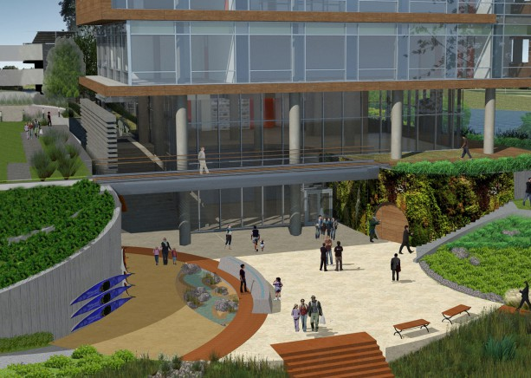
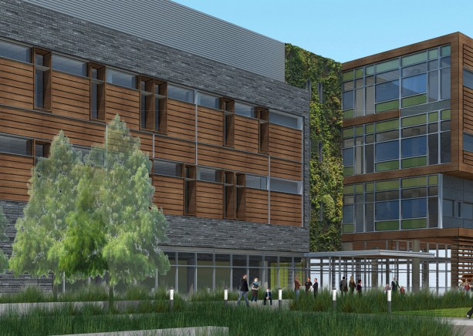
The Potomac Science Center
For George Mason University
Woodbridge, Virginia
Sean Fyalkowski
Mechanical Option
Spring 2016
Advisor: Dr. Treado

Slide 2
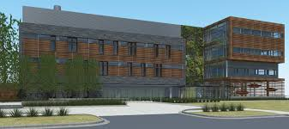
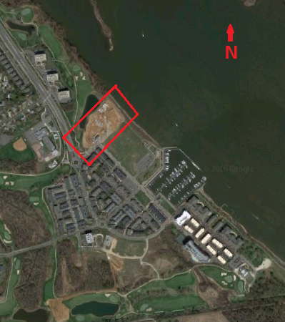
The Potomac Science Center
Woodbridge, VA
Building Introduction
Project Introduction
Proposal
Mechanical Depth
Site Characteristics
Equipment
Installation
Energy Modeling
Energy Comparison
Construction Breadth
Cost Comparison
Concluding Remarks
Primary Occupant: George Mason University
Size: 50,000 square feet, 4 stories
Approximate Construction Dates: Oct 2014-October 2016
Architect: HKS and ZGF
Mechanical and Electrical: GHT Limited
Primary Usage: Educational
Woodbridge, Virginia
Notes:
Waterfront building comprised of wet labs, lecture rooms, offices, spatial analysis laboratory, and library. 4 stories above ground. Provides much needed Environmental Science Research Space along the Chesapeake Bay Watershed

Slide 3
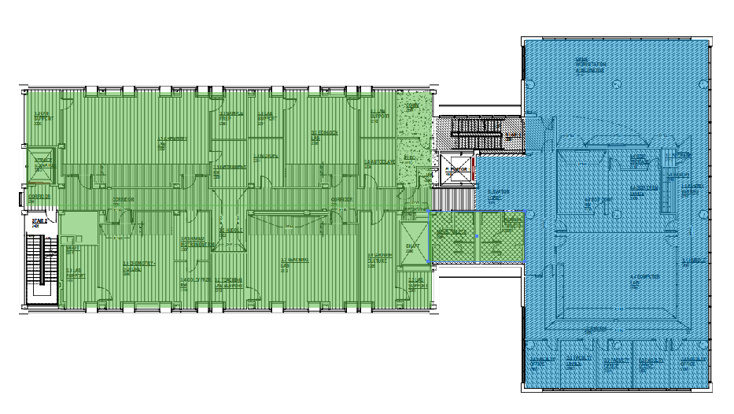
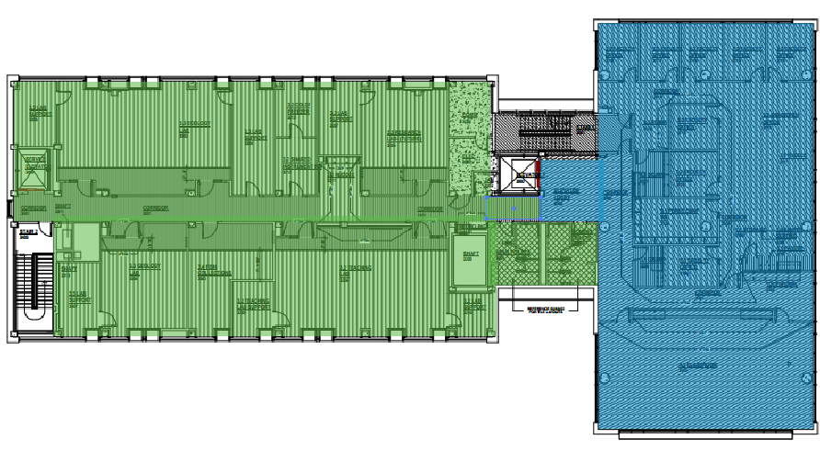
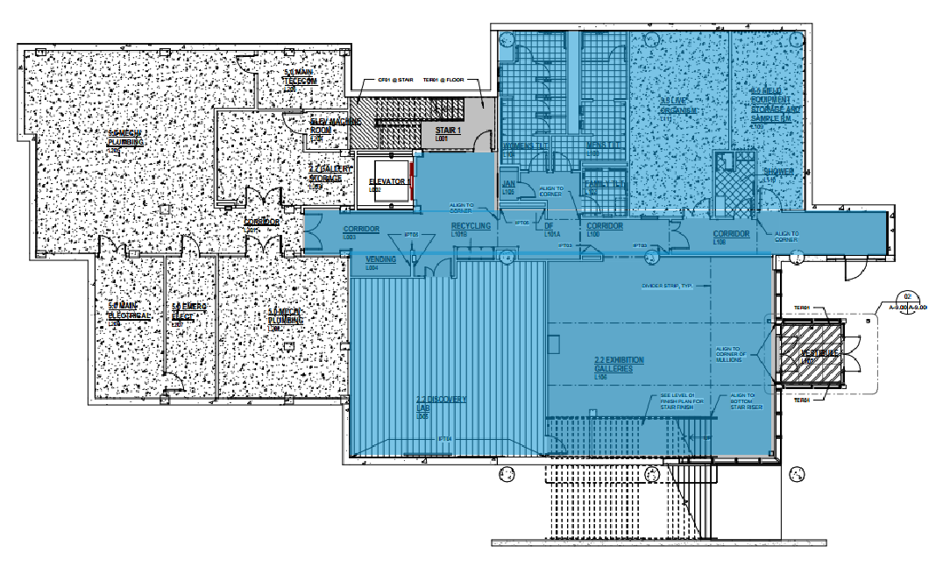
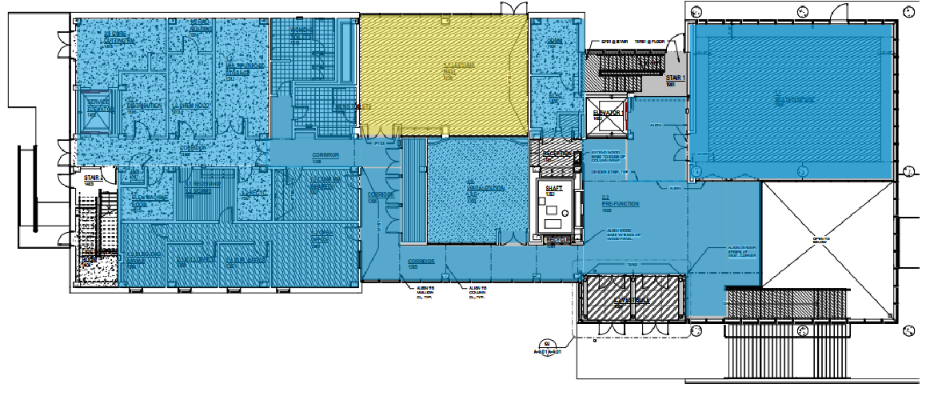
The Potomac Science Center
Woodbridge, VA
Mechanical System Description
Design and Calculated Existing Conditions
Project Introduction
Proposal
Mechanical Depth
Site Characteristics
Equipment
Installation
Energy Modeling
Energy Comparison
Construction Breadth
Cost Comparison
Concluding Remarks
-RTU-1 (green) 100% OA DOAS system services 2nd and 3rd floor labs.
-AHU R-1 (Blue) Chilled water air handling unit services river level, 1st, 2nd, and 3rd floors
-AHU 1-1 (yellow) chilled water air handling unit services lecture hall 1st floor
- 1.5kW and 5kW backup electric heaters
System | Total Supply/ OA (CFM) |  | Cooling (MBH) |  | Heating (MBH)
 | Design | Calculated | Design | Calculated | Design | Calculated
RTU-1 | 31,000 | 20,524 | 1,445 | 770 | 1,705 | 323
AHU 1-1 | 2,650 | 484 | 190 | 135 | 320 | 148
AHU R-1 | 6,700 | 3,421 | 1,192 | 1,247 | 945 | 1,411
River Level
First Floor
Second Floor
Third Floor

Slide 4
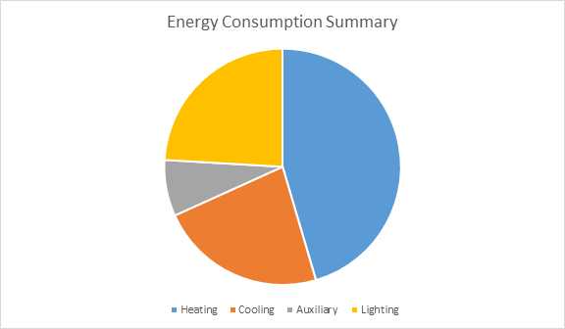
The Potomac Science Center
Woodbridge, VA
Energy Usage and Emissions
Energy Analysis
 | kWh | Total Building Energy (kBtu/yr)
Heating | 248,062 | 4,211,598
Cooling | 404,528 | 1,827,758
Lighting | 460,567 | 1,571,916
Auxiliary | 172,332 | 588,169
Total | 1,295489 | 8,199,441
Project Introduction
Proposal
Mechanical Depth
Site Characteristics
Equipment
Installation
Energy Modeling
Energy Comparison
Construction Breadth
Cost Comparison
Concluding Remarks
Environmental Impact Analysis
CO2 | 2,839,892 lbm/year
SO2 | 10,152 gm/year
NOX | 4,334 gm/year
After analysis of energy consumption and environmental impact, it was decided to study and implement an alternative system in place of AHU R-1

Slide 5
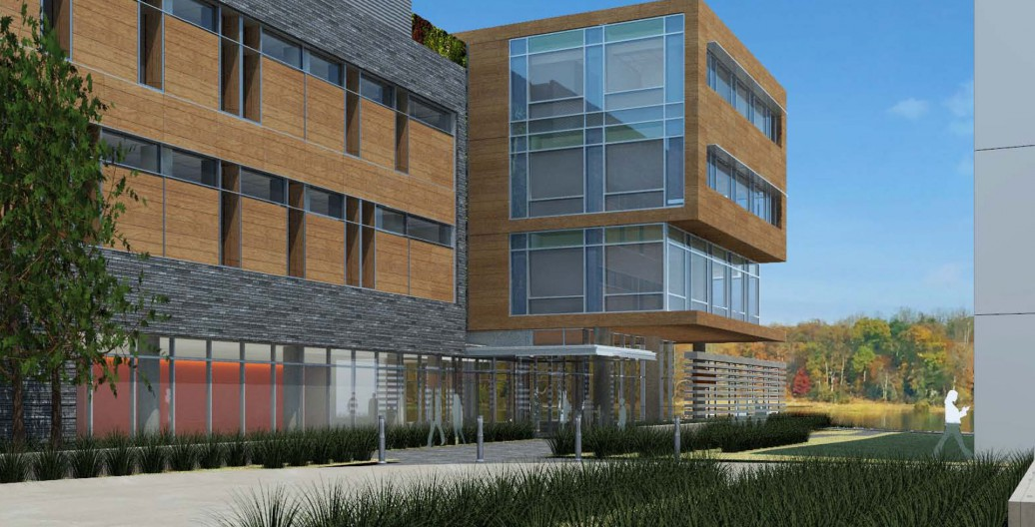
The Potomac Science Center
Woodbridge, VA
Proposed Alternative Goals
Project Introduction
Proposal
Mechanical Depth
Site Characteristics
Equipment
Installation
Energy Modeling
Energy Comparison
Construction Breadth
Cost Comparison
Concluding Remarks
Reduce energy consumption
Implement an environmentally friendly mechanical system
Reduce annual energy costs associated with heating and cooling
Install system with little or no change on construction timeline

Slide 6
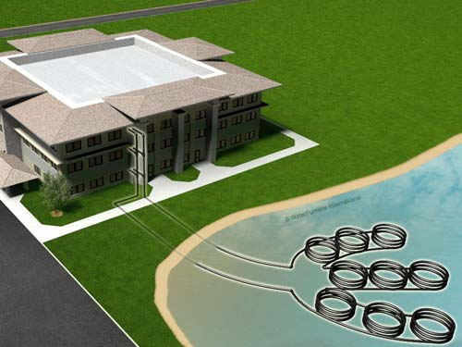
The Potomac Science Center
Woodbridge, VA
Proposed Alternative Solution
Project Introduction
Proposal
Mechanical Depth
Site Characteristics
Equipment
Installation
Energy Modeling
Energy Comparison
Construction Breadth
Cost Comparison
Concluding Remarks
Surface Water Geothermal System
Low first cost for geothermal system
Low pumping energy requirements
Low maintenance requirements
Low operating cost
Environmentally friendly
Constant thermal properties

Slide 7
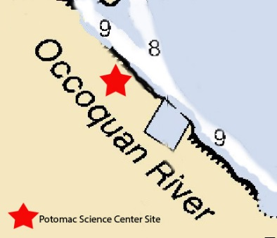
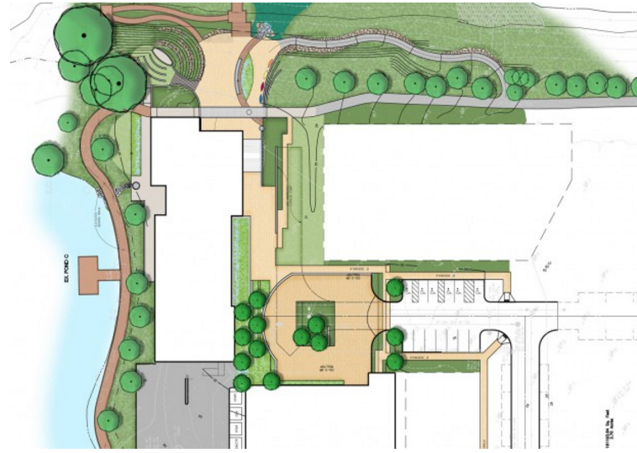
The Potomac Science Center
Woodbridge, VA
Site Characteristics
Project Introduction
Proposal
Mechanical Depth
Site Characteristics
Equipment
Installation
Energy Modeling
Energy Comparison
Construction Breadth
Cost Comparison
Concluding Remarks
Occoquan River
Located next to site
Depth between 8 and 9 feet
Average water temperature between 37F and 82F
Heat loss and gain neglected due to close proximity to building
Month | JAN | FEB | MAR | APR | MAY | JUN | JUL | AUG | SEP | OCT | NOV | DEC
Washington DC (T=F) | 37 | 37 | 46 | 57 | 67 | 76 | 81 | 82 | 75 | 61 | 52 | 41
Nautical Chart
Site Plan
Average Water Temperature

Slide 8
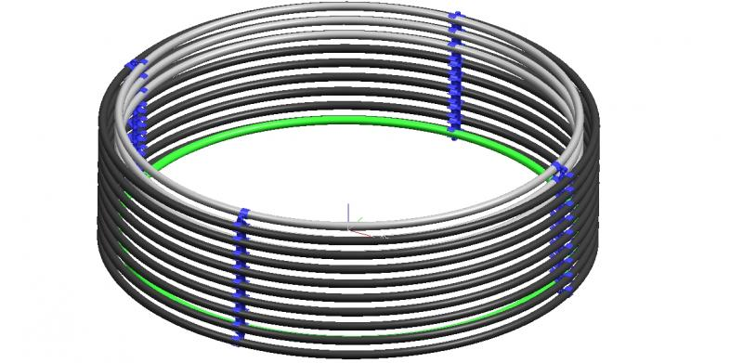
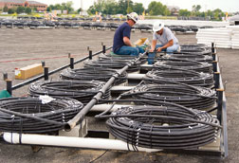
The Potomac Science Center
Woodbridge, VA
Pipe Design
Project Introduction
Proposal
Mechanical Depth
Site Characteristics
Equipment
Installation
Energy Modeling
Energy Comparison
Construction Breadth
Cost Comparison
Concluding Remarks
1”D High Density Polyethene (HDPE) piping will used as heat exchange element
20m of piping per kW heating/cooling load
Twenty, 275m coils spaced 2m apart
5500m total piping
Advantages
Durability
Corrosion resistance
Limited number of joints
Coil Layout
Piping Coil

Slide 9
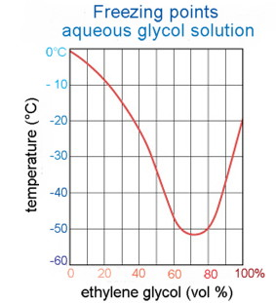
The Potomac Science Center
Woodbridge, VA
Antifreeze Solution Selection
Project Introduction
Proposal
Mechanical Depth
Site Characteristics
Equipment
Installation
Energy Modeling
Energy Comparison
Construction Breadth
Cost Comparison
Concluding Remarks
To avoid freezing, Propylene Glycol used as antifreeze solution
Circulated through submerged coils
Coil Layout
Solution | Percent by Volume | Freezing Point F | HDPE Pipe |  | Liquid Flow Rate 3gpm
Propylene Glycol | 20 | 19 | 1” pipe | h/100ft | 0.6
 |  |  |  | Re | 2230

Slide 10
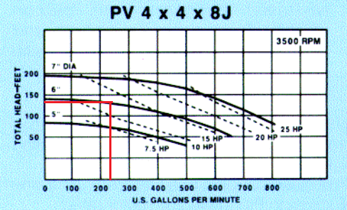
The Potomac Science Center
Woodbridge, VA
Circulation Pump Selection
Project Introduction
Proposal
Mechanical Depth
Site Characteristics
Equipment
Installation
Energy Modeling
Energy Comparison
Construction Breadth
Cost Comparison
Concluding Remarks
In line centrifugal pump selected from Peerless Pump Company
Head loss based off of HDPE pipe length and friction loss
18,044 ft HDPE piping, 135ft head loss
Friction loss, 1ft
Size | Head | Flow Rate | RPM | HP | Manufacturer
4x4x8 | 136 ft | 236 gpm | 3500 | 15 | Peerless

Slide 11
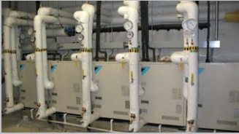
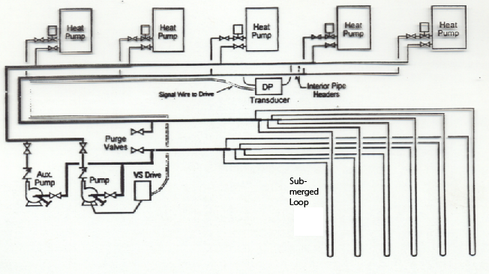
The Potomac Science Center
Woodbridge, VA
Water Cooled VRV Unit Selection
Project Introduction
Proposal
Mechanical Depth
Site Characteristics
Equipment
Installation
Energy Modeling
Energy Comparison
Construction Breadth
Cost Comparison
Concluding Remarks
Daikin Series VRV-WII units selected
Placed in series to meet load
Designed for 1,200 MBH cooling and 950 MBH heating capacity
Layout consists of 4x 21ton + 18 ton
 | Unit | 21 ton | 18 ton
Heating | Capacity (Btuh) | 270,000 | 232,000
 | COP | 4.5 | 4.5
Cooling | Capacity (Btuh) | 252,000 | 206,000
 | EER | 21.5 | 21.5

Slide 12
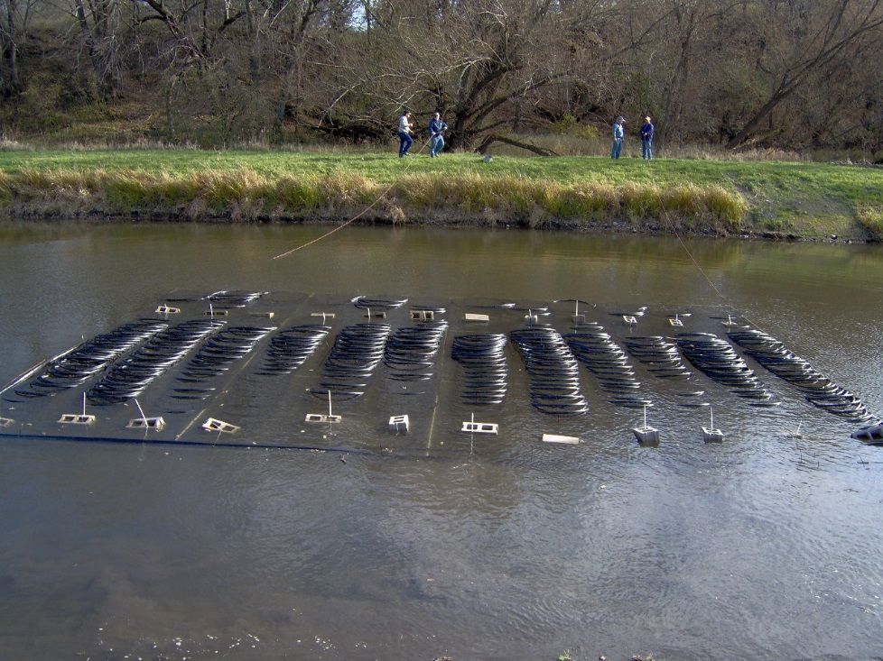
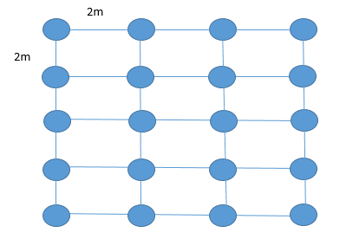
The Potomac Science Center
Woodbridge, VA
Installation
Project Introduction
Proposal
Mechanical Depth
Site Characteristics
Equipment
Installation
Energy Modeling
Energy Comparison
Construction Breadth
Cost Comparison
Concluding Remarks
Twenty, 275m coils will be placed into framework
Coils spaced 2m apart
Floated into place on river and submerged
No drilling needed compared to ground source geothermal systems

Slide 13
The Potomac Science Center
Woodbridge, VA
Energy Modeling of Alternative System
Project Introduction
Proposal
Mechanical Depth
Site Characteristics
Equipment
Installation
Energy Modeling
Energy Comparison
Construction Breadth
Cost Comparison
Concluding Remarks
Energy modeling done in TRACE 700
Constant temperature of the river and limited fossil fuels led to efficient design
 | kWh | Total Building Energy (kBtu/yr) | Total Source Energy (kBtu/yr)
Heating | 188,385 | 3,070,254 | 3,361,523
Cooling | 197,445 | 892,128 | 2,676,105
Lighting | 460,567 | 1,571,916 | 4,716,220
Auxiliary | 172,332 | 588,169 | 1,764,683
Total | 1,018,729 | 6,122,467

Slide 14
The Potomac Science Center
Woodbridge, VA
Energy Comparison of Systems
Project Introduction
Proposal
Mechanical Depth
Site Characteristics
Equipment
Installation
Energy Modeling
Energy Comparison
Construction Breadth
Cost Comparison
Concluding Remarks
18.4% emission savings
Average of 19% savings on energy consumption
Environmental Impact Analysis | Original Design | Proposed Design | Savings
CO2 | 2,839,892 lbm/year | 2,317,351 lbm/year | 18.4%
SO2 | 10,152 gm/year | 8,284 gm/year | 18.4%
NOX | 4,334 gm/year | 3,536 gm/year | 18.4%
System |  | kWh | Total Building Energy (kBtu/yr) | Total Source Energy (kBtu/yr)
Original System | Heating | 248,062 | 4,211,598 | 4,611,144
 | Cooling | 404,528 | 1,827,758 | 5,483,823
Proposed Alternative | Heating | 188,385 | 3,070,254 | 3,361,523
 | Cooling | 197,445 | 892,128 | 2,676,105
Savings | Heating | 59,677 | 1,141,344 | 1,249,621
 | Cooling | 207,084 | 935,657 | 2,807,718

Slide 15
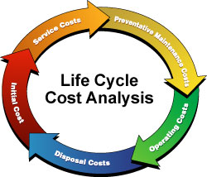
The Potomac Science Center
Woodbridge, VA
Construction Study Goals
Project Introduction
Proposal
Mechanical Depth
Site Characteristics
Equipment
Installation
Energy Modeling
Energy Comparison
Construction Breadth
Cost Comparison
Concluding Remarks
Evaluate and compare alternative system costs
Evaluate life cycle cost and feasibility

Slide 16
The Potomac Science Center
Woodbridge, VA
Cost Comparison
Original Design ($)
Materials | 27,328
Labor | 2,632
Total | 29,960
Total inc O&P | 34,160
Project Introduction
Proposal
Mechanical Depth
Site Characteristics
Equipment
Installation
Energy Modeling
Energy Comparison
Construction Breadth
Cost Comparison
Concluding Remarks
Annual Energy and Cost Savings
System |  | kWh | Total Building Energy (kBtu/yr) | Total Source Energy (kBtu/yr) | Cost
Original System | Heating | 248,062 | 4,211,598 | 4,611,144 | $103,639
 | Cooling | 404,528 | 1,827,758 | 5,483,823
Proposed Alternative | Heating | 188,385 | 3,070,254 | 3,361,523 | $81,498
 | Cooling | 197,445 | 892,128 | 2,676,105
Savings | Heating | 59,677 | 1,141,344 | 1,249,621 | $22,141
 | Cooling | 207,084 | 935,657 | 2,807,718
Alternative Proposed Design
Selection | Material Cost ($) | Labor Cost ($) | Total Cost ($)
Circulating Pump | 10,800 | 850 | 11,650
Propylene Glycol Solution | 6,585 | - | 6,585
Controls | 1,325 | 1,075 | 2,400
Loop (Piping, heat pump, etc) | 145,048 | 20,620 | 165,668
 |  | Total | 186,303

Slide 17
The Potomac Science Center
Woodbridge, VA
Cost Comparison
Federal Tax Rebate
10% of initial material and labor cost
EER ≥ 14.1
COP ≥ 3.3
Project Introduction
Proposal
Mechanical Depth
Site Characteristics
Equipment
Installation
Energy Modeling
Energy Comparison
Construction Breadth
Cost Comparison
Concluding Remarks
Initial cost higher proposed design
$22,000 annual energy savings
10% federal tax rebate
Payback period of 7.5 years
Payback Period
System First Cost ($) | 186,303
10% Federal Rebate ($) | 167,672
Yearly Energy Savings ($) | 22,141
Payback Period with rebate | 7.56 years

Slide 18
The Potomac Science Center
Woodbridge, VA
Conclusion
Project Introduction
Proposal
Mechanical Depth
Site Characteristics
Equipment
Installation
Energy Modeling
Energy Comparison
Construction Breadth
Cost Comparison
Concluding Remarks
System Initial Cost- $186,000
Annual Energy Savings-$22,000
18.4% reduction in emissions
10% federal tax rebate
7.5 year payback period

Slide 19
The Potomac Science Center
Woodbridge, VA
Acknowledgements
Project Introduction
Proposal
Mechanical Depth
Site Characteristics
Equipment
Installation
Energy Modeling
Energy Comparison
Construction Breadth
Cost Comparison
Concluding Remarks
Friends and Family
GHT Limited
Dr. Stephen Treado
AE Faculty

